Slide 1

Copyright 2009 Davitily

Slide 2
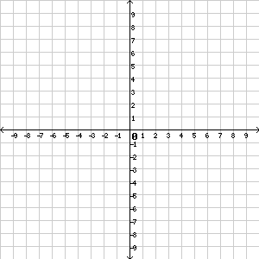
Graph a Line Using an x-y Table
Step 2:
This gives us 3 ordered pairs
to plot and graph.
Step 1:
Pick numbers for x.
Step 2:
Substitute x to find y.
Step 3:
Plot the ordered pairs (x,y).
Step 4:
Draw line.
Step 4:
Draw line.
Don't forget to include
arrows on both end of
the line to indicate it is
continuous.
Step 1:
Pick at least 2 numbers for x.
In this case, we will use 3
numbers for a more precise
graph as we will have 3
ordered pairs to plot.
Step 2:
Substitute x into the equation
to find y.
Step 3:
Plot the ordered pairs.

Slide 3
For more practice, visit
www.mathproblemgenerator.com

